Slide 1
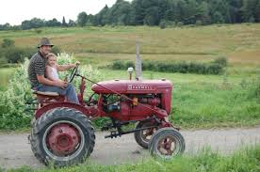
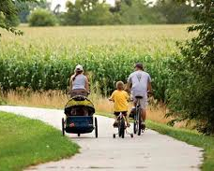
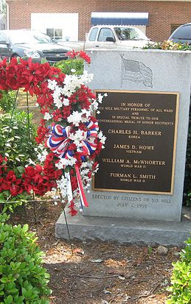
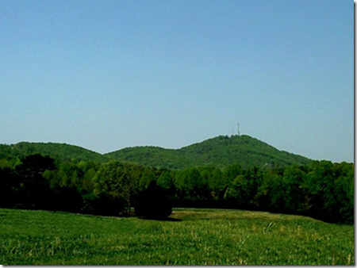
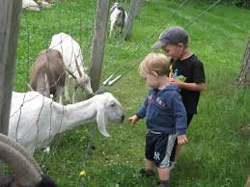
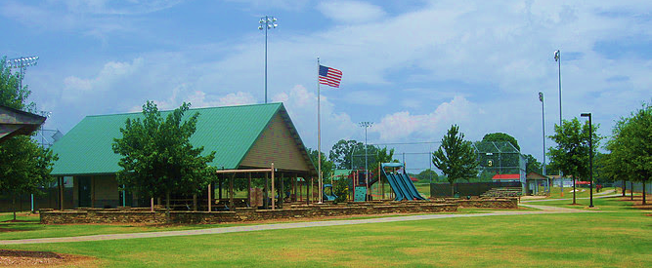
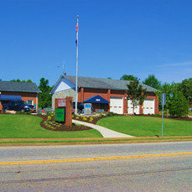
Six Mile, S.C. History
Youth
Recreation

Slide 2
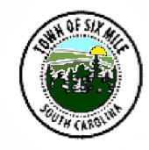
Six Mile History

Slide 3
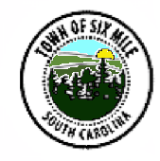
History
The Town of Six Mile, South Carolina (founded 1910) is just a short distance north of Clemson, South Carolina and Clemson University. The area now known as Six Mile once belonged to the Cherokee Nation.
A popular legend says that Six Mile was named by the Indian maiden, Issaqueena, who rode her horse on a journey of ninety-six miles to warn her lover, an English trader named Francis Allen, of a coming Cherokee attack. Issaqueena numbered the creeks she crossed. There is a town called Ninety Six, and many other “number names” on the path; these include Mile Creek, Six Mile, Twelve Mile River, and Six and Twenty Creek.

Slide 4
The Cherokee Trading Path once passed through Six Mile, roughly approximating the current route of Main Street.
Six Mile derived its name from its location along the path which was six miles east of the Cherokee town of Keowee and later the trading post at Fort Prince George.
In the late 1700’s settlers of Scotch-Irish and English ancestry moved into the former Cherokee area.
The Town has progressed from a rural agricultural community (when cotton farming no longer became profitable after World War II) to a town with a caring attitude and beauty making Six Mile a great place to live and raise a family.

Slide 5
Six Mile contains many important historic sites including houses, farms, barns, roads/trails (Cherokee Trading Path, John Ewing Colhoun), commercial buildings (masonic lodge and nursing home that once housed the Peek Hospital), and other sites representing over two centuries of area settlement. These irreplicable elements of our heritage illuminate the history of Six Mile, maintain the town’s character, and enhance the quality of life for all.
A historic pictorial display in the Town’s Community Room (completed in 2010 to coincide with the town’s 100th anniversary) depicts much of the town’s history through the decades.

Slide 6
Electrical and Other
Work on constructing an electric light power line from a plant of Lenhart Light and Power Company on Twelve Mile River proceeded such that May of 1926 Six Mile had voted $5000 in bonds for electric lights and a line was in process of installation. Six Mile was touted as being in the center of one of the best agricultural communities in the State and home of Dr. Peek’s Hospital (the only hospital in Pickens County). An article in the Pickens Sentinel Newspaper on March 3, 1927, noted that the “progressive little town of Six Mile” had electric light service. This was significant achievement for Six Mile as it was not till August 29, 1938, that a meeting was held to organize a county cooperative of electrification association.
In the late 1960’s Duke Energy constructed a nuclear power generating complex near Six Mile.

Slide 7
Lake Issaqueena Bombing Range
This approximately 4100-acre site near Six Mile was acquired by the War Department from the Clemson Agricultural College under an occupation permit in 1942. The range was used for medium altitude and skip bombing exercises and officially closed in September 1945 and declared a Formerly Used Defense Site (FUDS) on December 17, 1945. The former range was composed of two main Munitions Response Sites (MRS) – The Practice Bombing Range MRS and the Skip Bombing Target MRS along with a potential 3rd Target MRS to the North. The Practice Range and skip Target MRS are located within the Clemson University Experimental Forest. The Potential Target MRS is located on land owned by Crescent Properties and Duke Energy.

Slide 8
Combined with recognizing its past, Six Mile looks to the future with a PROGRESSIVE Comprehensive Plan that PROMOTES AND RECOGNIZES GREENSPACE IN A COMMUNITY ORIENTED FAMILY SETTING.
The area encompasses some of the top rated schools in the area (Six Mile Elementary, Edwards Middle and D.W. Daniel High Schools) in addition to one of the finest recreation facilities and programs in the area.

Slide 9
The achievements of Six Mile, recent and future, are not exclusive of its ties to the past. The town has always had a history of residents pulling together to accomplish needed goals. Be it in times past, residents pulling together to contribute personal funds and guaranteed loans for a water system and fire department in the 1960’s and 1970’s, to donate materials and labor to build a downtown church and potentially a hospital on top of Six Mile Mountain in the 1930’s and 1940’s (which would have been completed if not for the untimely death of Dr. David E. Peek), to rebuild the town after a devastating tornado in the 1920’s, to “rolling up their sleeves” in 2014 and gut an historic downtown bank building to bring about the return of banking to Downtown Six Mile – in all these examples, we see the people of Six Mile pull together in whatever way needed whenever. Today’s Six Mile thinks on that same volunteer spirit!

Slide 10
Six Mile prides itself in that three of four Pickens County, South Carolina Medal of Honor Recipients are from the Six Mile area.

Slide 11
Recent Town Achievements
The Town of Six Mile was awarded in 2015 an Achievement Award by the Municipal Association of South Carolina for a town in its population size range based on its unique project with “Our Bank” which returned banking to Downtown Six Mile via a unique cooperative venture between the Town, the outgoing bank, and an incoming bank. The town received the bank site for free to and currently receives rental income from the location.
Recent downtown growth to include a dental office, coffee drive thru, ice cream shop, attorney office, and two chain stores.

Slide 12
Downtown Town Park with pavilion currently under construction.
Bryson Children's Nature Walk, located on N. Main Street. The town received the conservation easement protected site for free. Plans include 1 ½ miles of walking trails, children's garden area, a boardwalk and viewing area overlooking the beaver/duck pond, and a children's outdoor learning center.

Slide 13
Farmer’s Market downtown (Six Mile Farmer’s Depot) (TV Promos to include “Making it Grow”)
Halloween Festival
For over five decades one of the largest and most successful downtown Christmas parades in Pickens County
Issaqueena Festival – one of the largest downtown festivals in the area
July 4th Festival at Ponderosa Park

Slide 14
Six Mile Mountain
What other town in the tri-county area of upstate SC area has a downtown setting overlooking a mountain scene?

